Slide 1

GyanVerse.AI
All-in-one AI-powered study assistant
Developed by Team CodeVengers

Slide 2
Problem statement
Students waste time juggling multiple apps for notes, doubts, revision, and tracking, leading to confusion and poor learning habits. A single AI-powered study assistant can fix this by unifying everything, answering syllabus-based queries, planning revisions, and making learning engaging and personalized.

Slide 3
The proposed solution
We have come up with a solution to this problem i.e. GyanVerse.AI which automatically ingests your raw learning materials and instantly converts them into structured, personalized, and active study tools.

Slide 4
What makes this special ?
Complete RAG Implementation: Real vector embeddings and semantic search
Production-Quality Code: Clean architecture, proper error handling
Hackathon-Perfect: Impressive features that solve real problems
Scalable Foundation: Ready for additional features and scaling

Slide 5
functionalities
The application is completely functional and includes:
User Flow: Register → Login → Upload Documents → Ask Questions → Generate Quizzes → View Analytics
Mock Data: Pre-populated with example stats and activities for demo
Professional UI: Clean, modern interface that looks production-ready
API Documentation: All endpoints documented with usage examples

Slide 6
Technical implementations
React components with Tailwind CSS
Responsive design for all devices
Smooth routing between landing page and app
Authentication-aware navigation
SEO-friendly structure
This landing page is designed to convert visitors into users by clearly showing the value, building trust through social proof, and making it effortless to get started.

Slide 7
Tech stack
Backend – Node.js, JSON ChatRoutes.js FileRoutes.js
AI engine - FastAPI, langchain,GPT-5, RAG-pipeline
Automation - N8N
Frontend- React, Next.js, chat.js
Database setup - PostgreSQL, MongoDB, Pinecone
Deployment - API key
Machine learning
Diff python libraries Integration to FastAPI
To Fetch analytics data – Axios
Dashboard.jsProgresschart.jsxWeaktopilist.jsx

Slide 8
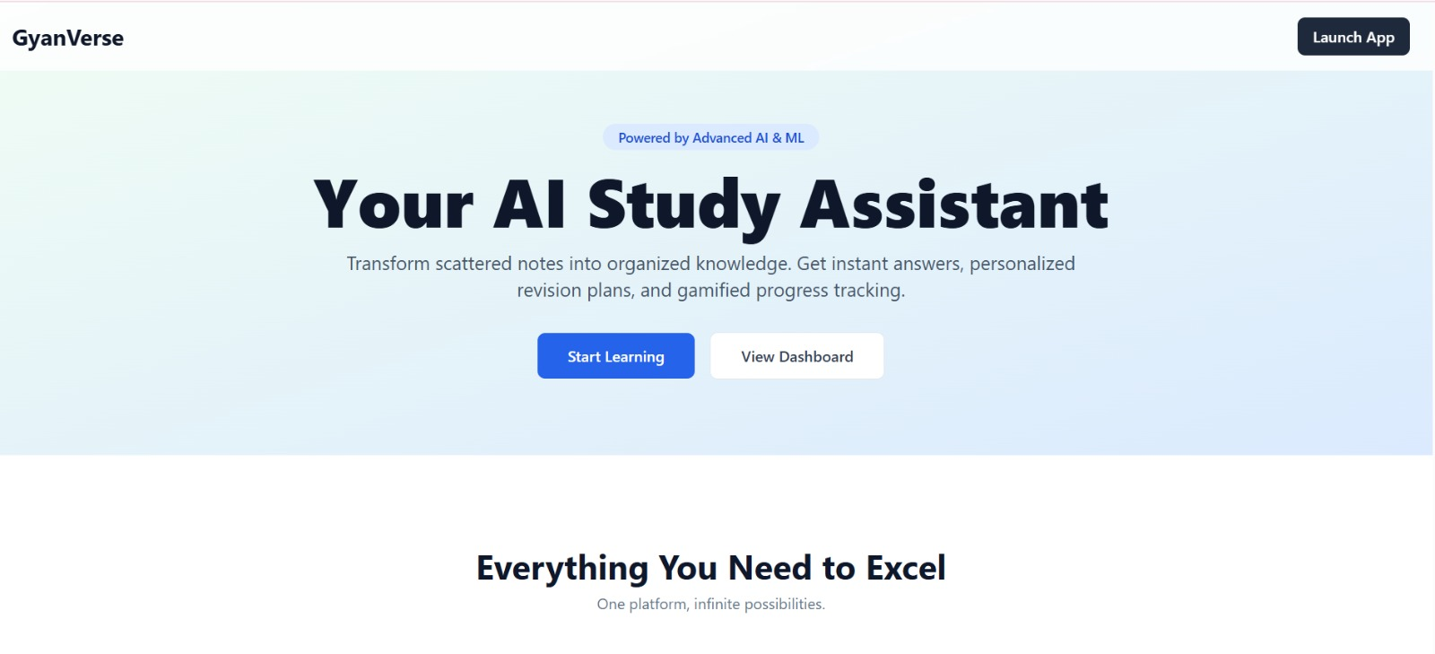
prototype

Slide 9
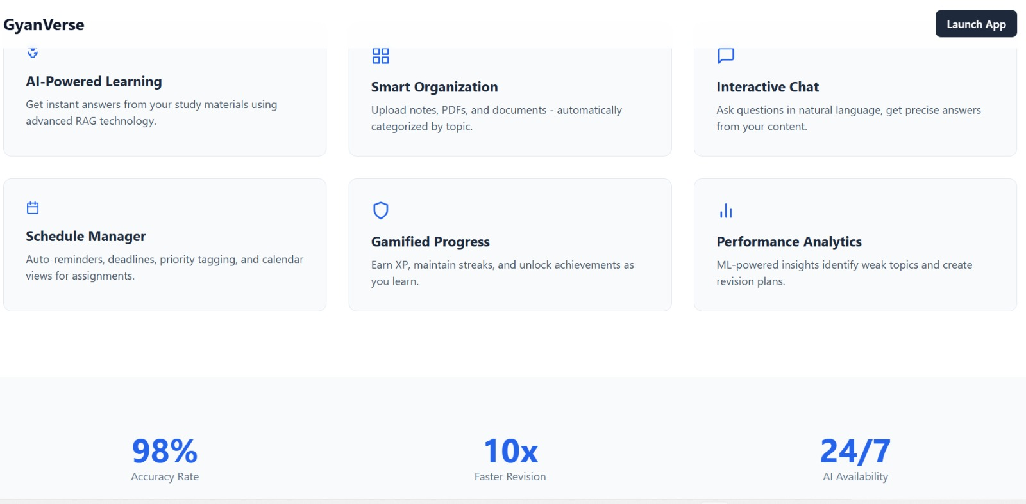
prototype

Slide 10
Thank you

